Slide 1
Website
Sistem
Informasi
Sekolah
Andreas Aprillian
SMKN 1 Sumedang
XI-RPL 2

Slide 2

Theme
Materialize Design

Slide 3

Framework
CodeIgniter

Slide 4
Model CI
Precentation Logic
Web Interface
Model
MVC
View
Database
Manipulate CRUD (Create, Read, Update, Delete)
Controller

Slide 5

Bootstrap

Slide 6
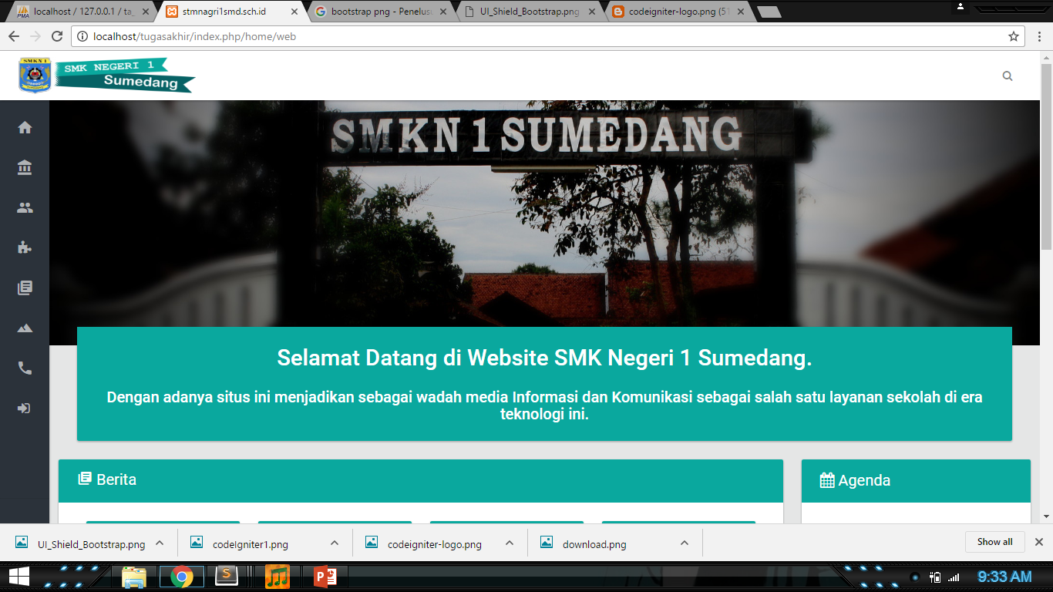
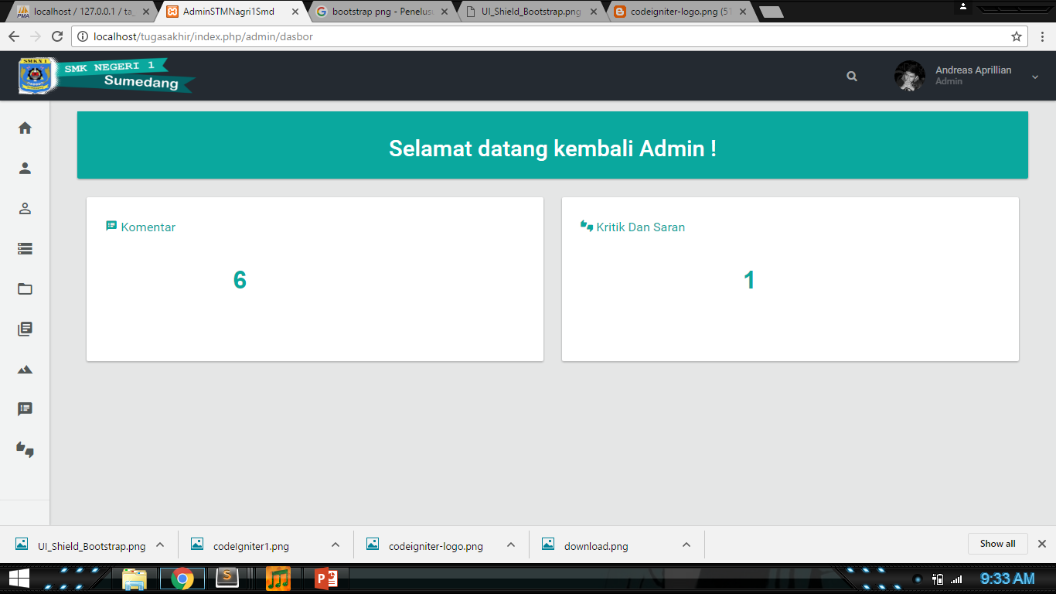
User Interface
Home
Dashboard Admin

Slide 7
Flowchart Login Admin
Mulai
Login
Salah ID Atau Password
Verifikasi
Dashboard
Admin
Selesai

Slide 8
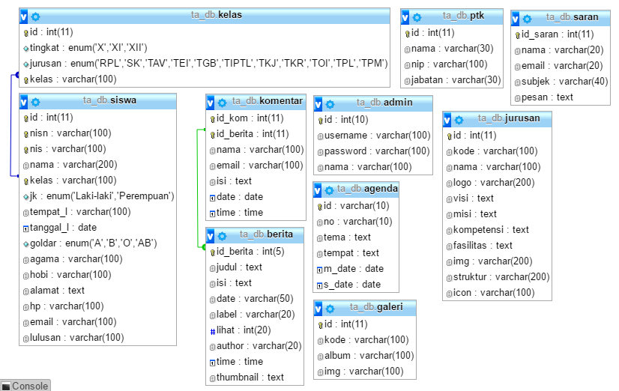
Table Relations

Slide 9



References
Official Website
smkn1sumedang.sch.id
Themeforest.net
themelock.com

Slide 10



Software
XAMPP
Sublime Text
CorelDRAW X7

Slide 11

Special Thanks
Allah SWT
Nabi Muhammad SAW
Kedua Orang Tua
Pak Rudi Sutedja
Kang Irvan
Kang Aji
Kang Tahir
Kang Faisal
Kang Kim
Uni
Para Senior CCA
Oji
Ozan
Khalid
Chetus
Taupik
Willem
Alif
Acil
Anita
Silvi
Rahma
Kirana
Anak Jakarta (udah pulang)
Ibu Edi (kost)
Ibu sri
Warkit

